Slide 1
Algorithmics 3&4
UNIT 3 AOS1– abstract data types

Slide 2
Decision Trees

Slide 3
Decision Trees
A decision is a special type of tree (connected, directed, acyclic graph) used to model conditional processes
The nodes of the tree represent a ‘test’ on an attribute.
The edges represent outcomes arising from the source node.
The leaf nodes represent a class label (final result)

Slide 4
Decision Trees
A decision is a special type of tree (connected, directed, acyclic graph) used to model conditional processes
The nodes of the tree represent a ‘test’ on an attribute.
The edges represent outcomes arising from the source node.
The leaf nodes represent a class label (final result)
>= 18 years
<18 years
Vote
No vote

Slide 5
Decision Trees
A decision is a special type of tree (connected, directed, acyclic graph) used to model conditional processes
The nodes of the tree represent a ‘test’ on an attribute.
The edges represent outcomes arising from the source node.
The leaf nodes represent a class label (final result)
If age >= 18 then
vote ← True
Else
vote ← False
EndIf
>= 18 years
<18 years
Vote
No vote

Slide 6
Decision Trees
See enemy
Can’t see enemy
No weapon
Not near doorway
Near doorway
Has weapon
Fire
Flee
Patrol
Guard

Slide 7
Decision Trees
If enemy_in_sight = True then
If has_weapon = True then
state ← fire
Else
state ← flee
EndIf
Else
If near_doorway = True then
state ← guard
Else
state ← patrol
EndIf
EndIf

Slide 8
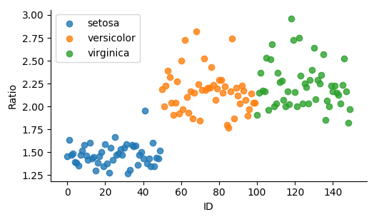
Draw a decision tree to (approximately) label an iris plant based on its Ratio and ID attributes

Slide 9
Decision Trees
ratio <= 1.7
ratio > 1.7
ID <= 100
ID > 100
Setosa
Verisicolor
Virginica

Slide 10
Adjacency Matrix
An adjacency matrix is another form of representing a graph
It is a square matrix, where the columns/rows represent the nodes and the elements represent the weights on the edge connecting the nodes

Slide 11
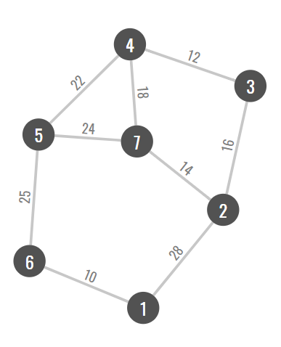
Adjacency Matrix
 | 1 | 2 | 3 | 4 | 5 | 6 | 7
1
2
3
4
5
6
7

Slide 12
Adjacency Matrix
 | 1 | 2 | 3 | 4 | 5 | 6 | 7
1 |  | 28
2
3
4
5
6
7

Slide 13
Adjacency Matrix
 | 1 | 2 | 3 | 4 | 5 | 6 | 7
1 |  | 28
2 | 28
3
4
5
6
7

Slide 14
Adjacency Matrix
 | 1 | 2 | 3 | 4 | 5 | 6 | 7
1 |  | 28 |  |  |  | 10
2 | 28
3
4
5
6
7

Slide 15
Adjacency Matrix
 | 1 | 2 | 3 | 4 | 5 | 6 | 7
1 |  | 28 |  |  |  | 10
2 | 28
3
4
5
6 | 10
7

Slide 16
Adjacency Matrix
 | 1 | 2 | 3 | 4 | 5 | 6 | 7
1 |  | 28 |  |  |  | 10
2 | 28 |  | 16
3 |  | 16
4
5
6 | 10
7

Slide 17
Adjacency Matrix
 | 1 | 2 | 3 | 4 | 5 | 6 | 7
1 |  | 28 |  |  |  | 10
2 | 28 |  | 16 |  |  |  | 17
3 |  | 16 |  | 12
4 |  |  | 12 |  | 22 |  | 18
5 |  |  |  | 22 |  | 25 | 24
6 | 10 |  |  |  | 25
7 |  | 14 |  | 18 | 24

Slide 18
Adjacency Matrix
 | 1 | 2 | 3 | 4 | 5 | 6 | 7
1 |  | 28 |  |  |  | 10
2 | 28 |  | 16 |  |  |  | 17
3 |  | 16 |  | 12
4 |  |  | 12 |  | 22 |  | 18
5 |  |  |  | 22 |  | 25 | 24
6 | 10 |  |  |  | 25
7 |  | 14 |  | 18 | 24
For undirected graphs, the adjacency matrix is mirrored about its diagonal. The matrix is also its own transpose.

Slide 19
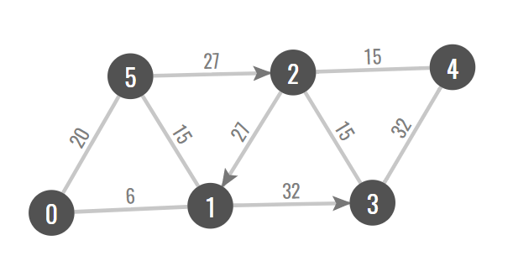
Draw an adjacency matrix for the following graph

Slide 20
Draw an adjacency matrix for the following graph
 | 0 | 1 | 2 | 3 | 4 | 5
0 |  | 6 |  |  |  | 20
1 | 6 |  |  | 32 |  | 15
2 |  | 27 |  | 15 | 15
3 |  |  | 15 |  | 32
4 |  |  | 15 | 32
5 | 20 | 15 | 27

Slide 21
Width of a graph
The width of a graph is the minimum distance required to ensure that it is possible to travel from any node to any other node.
It is the maximum of all of the minimum distances separating all pairs of nodes in a graph.

Slide 22
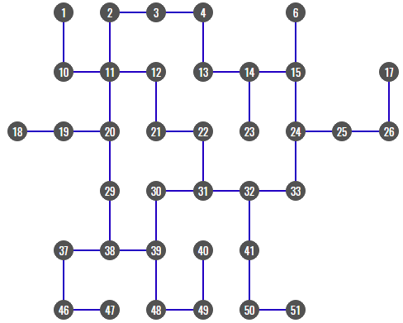
It is the maximum of all of the minimum distances separating all pairs of nodes in a graph.

Slide 23
It is the maximum of all of the minimum distances separating all pairs of nodes in a graph.

Slide 24
It is the maximum of all of the minimum distances separating all pairs of nodes in a graph.

Slide 25
It is the maximum of all of the minimum distances separating all pairs of nodes in a graph.

Slide 26
It is the maximum of all of the minimum distances separating all pairs of nodes in a graph.

Slide 27
It is the maximum of all of the minimum distances separating all pairs of nodes in a graph.

Slide 28
It is the maximum of all of the minimum distances separating all pairs of nodes in a graph.

Slide 29
It is the maximum of all of the minimum distances separating all pairs of nodes in a graph.

Slide 30
It is the maximum of all of the minimum distances separating all pairs of nodes in a graph.
What is the width of this graph?
TizH

Slide 31
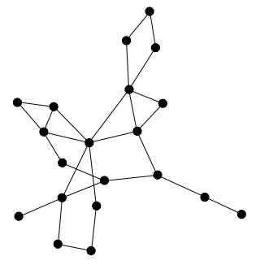
Width of a graph
If a graph has no weightings on its edges, the width simply refers to the number of edges that you have to traverse for the maximum-minimum separation of nodes.

Slide 32
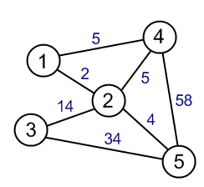
Width of a graph
If a graph has weightings on its edges, the width is then the addition of these weights that lead to the maximum-minimum separation of nodes.

Slide 33
Activity – Decision Trees and Adjacency Matrices
Complete the Check your Progress tasks on Canvas.

